Slide 1
The fascinating differences in the way we use our smartphones
Mohammed Topiwalla
Abraham Chandy
Patricia Londono
Fernanda De Oliveira Guimaraes
Hani Nabulsi

Slide 2
Project Objective
Our purpose is to provide insights for mobile phone stakeholders to help them target the right group of customers for new phone launches by helping them understand customer preferences and usage characteristics.

Slide 3
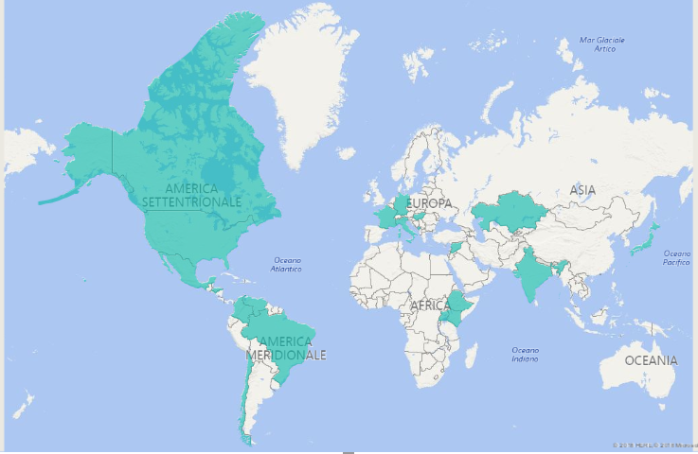
Methodology
A survey of 18 questions was sent to various people across the globe. Link to survey is here
110 responses were received
The complete project sits here

Slide 4
Analysis
Data cleaning was performed in python
Standardize for grammatical consistency
Correct column placements and addition of ID column
Exploratory data analysis
Using power BI
Descriptive statistics in SAS

Slide 5
Clustering
Variables in question 10
Checking perception bias
Standardizing variables
Principal component analysis
Clustering on new standardized variables
Clustering on first 4 components from PCA
Clustering Interpretation
T Test
Explanatory analysis

Slide 6
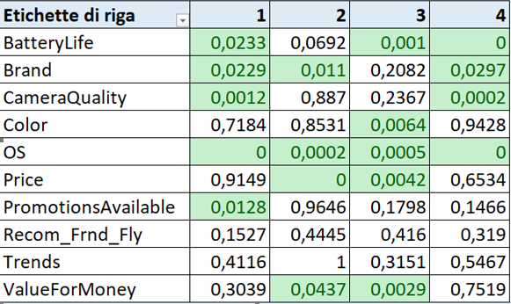
Equality of Variances - FOLDED F (Pr > F)

Slide 7
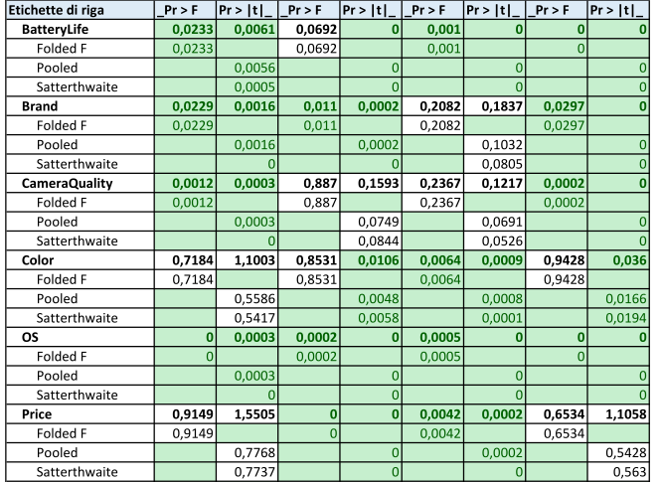
Ttest

Slide 8
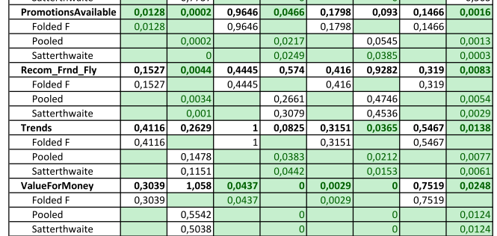

Slide 9
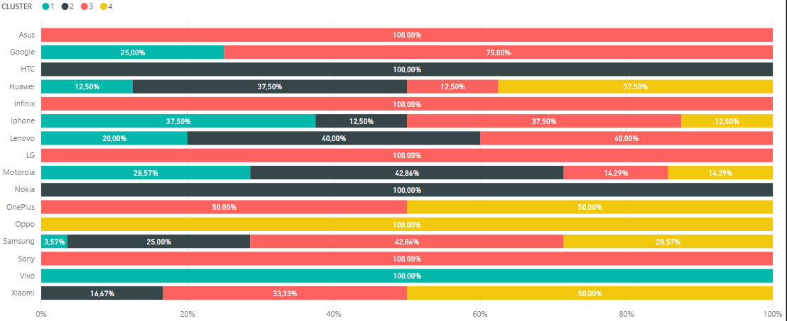
Cluster by brand

Slide 10
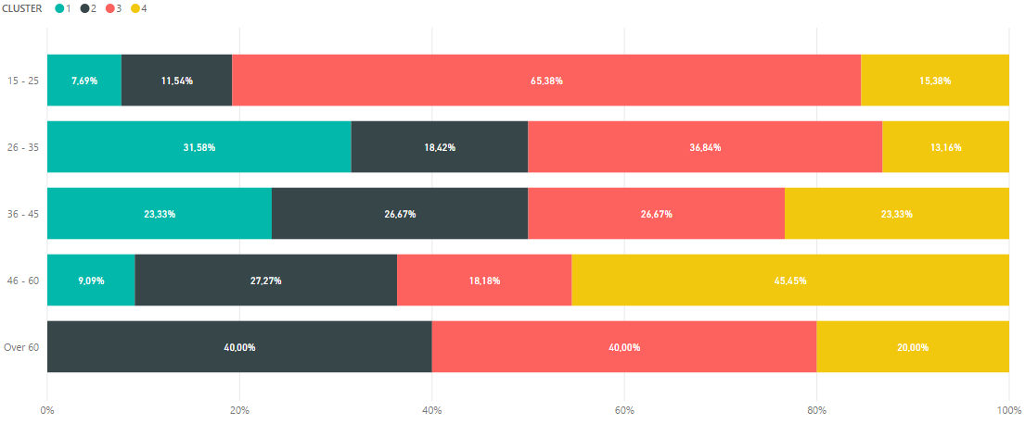
Cluster by age

Slide 11
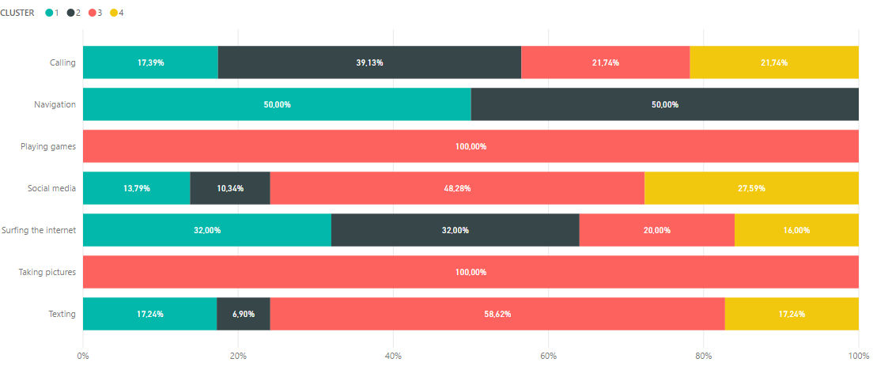
Cluster for primary use of phone

Slide 12
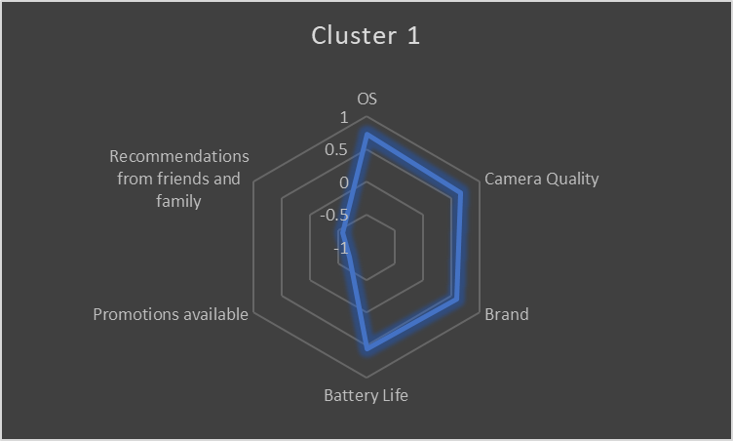
Cluster 1

Slide 13
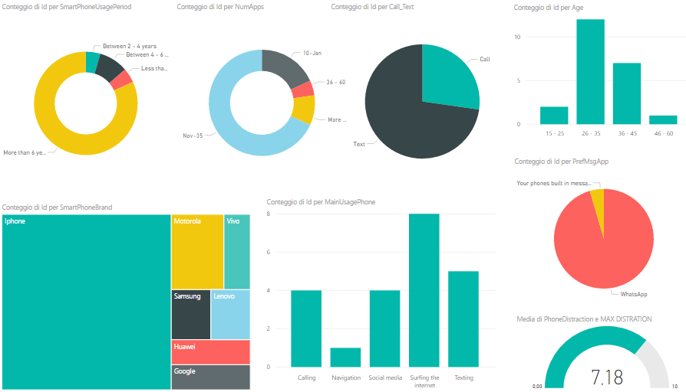
Cluster 1

Slide 14
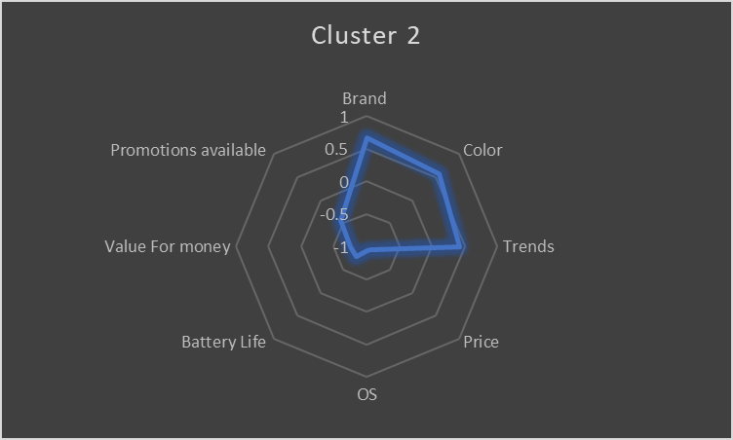
Cluster 2

Slide 15
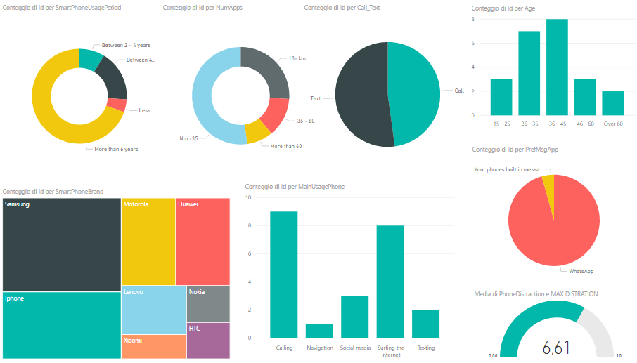
Cluster 2

Slide 16
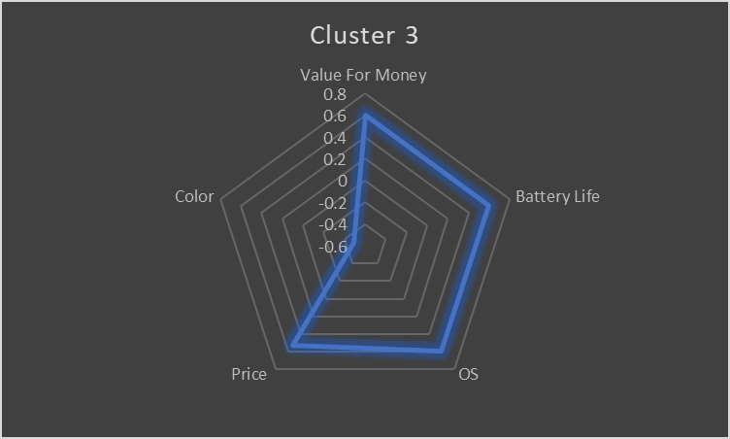
Cluster 3

Slide 17
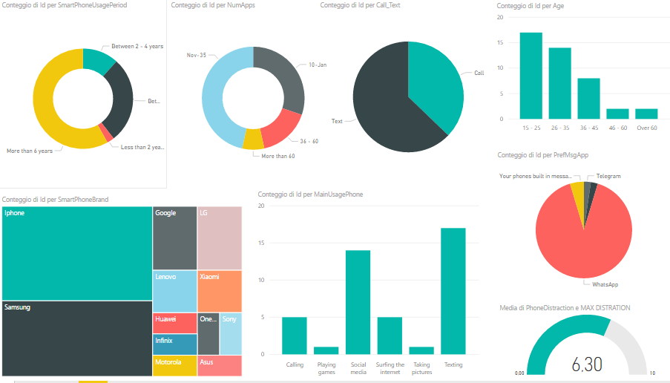
Cluster 3

Slide 18
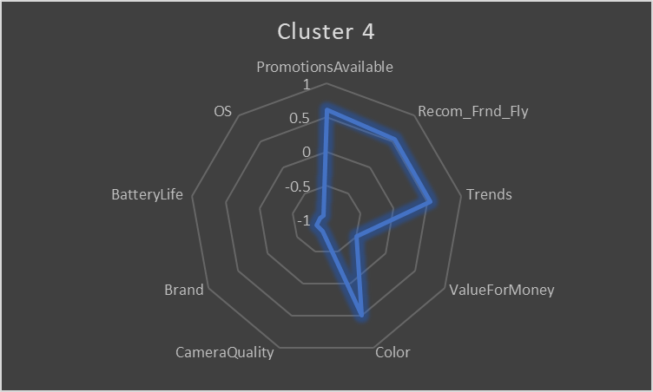
Cluster 4

Slide 19
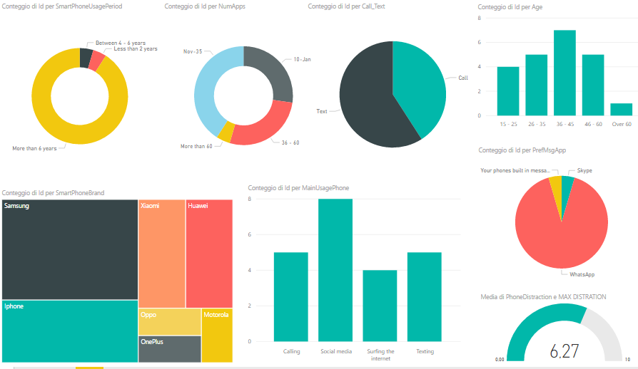
Cluster 4

Slide 20
Cluster Summary
Cluster 1
26 – 35
Main use - surfing
Love the Iphone
WhatsApp
Cluster 2
36 - 45
Main use – calling, surfing
Prefer Samsung
WhatsApp
Cluster 3
15 - 25
Main use – texting, social media
Iphone then Samsung
WhatsApp
Cluster 4
46 - 60
Main use – social media
Prefer Samsung
Skype, WhatsApp

